Slide 2
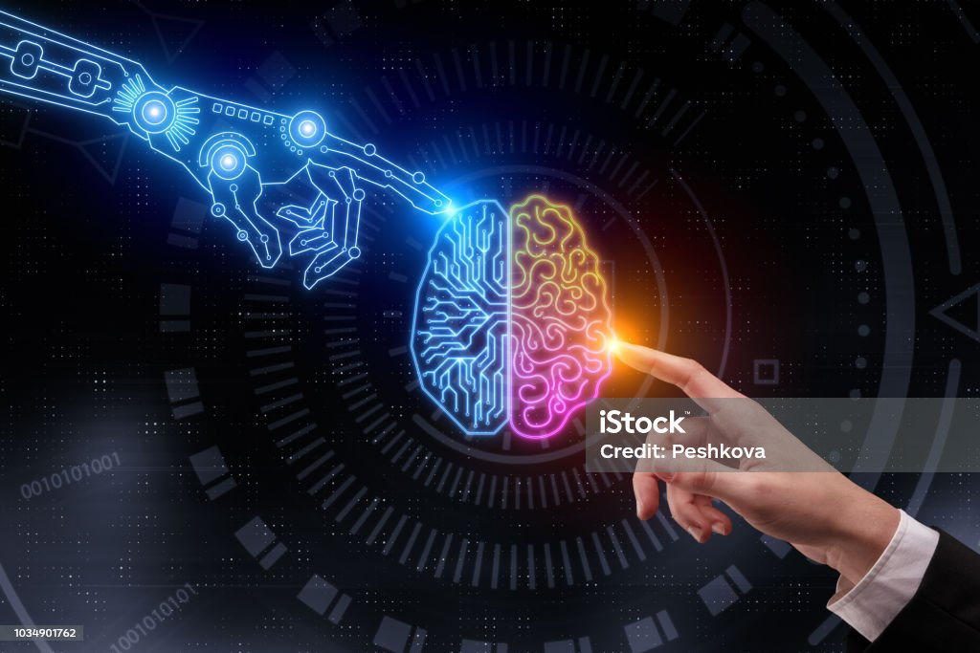
Introduction Artificial Intelligence and Explainability
Sub-symbolic Artificial Intellence (AI):
Dataset-based
Computationally expensive
No explanation for inferences (blackbox)
Symbolic AI:
Often cheaper (but narrower)
Native support for explainability
Logic-based
DatalogMTL
Source: https://www.istockphoto.com/de/foto/k%C3%BCnstliche-intelligenz-und-zukunftskonzept-gm1034901762-277068420

Slide 3
Introduction DatalogMTL
DatalogMTL (Brandt et al., 2018)
Ontology-based framework for:
Representing real-world events with time
Querying temporal data
Reasoning over data streams
Supports Metric Temporal Operators (MTO)
$$Immune\left(X\right)←{ \text{◇}}_{[10,183]}Infected\left(X\right), { \text{⊟}}_{[0,10]}NoSymptoms(X)$$
$$NegativeTest\left(X\right)← {\text{⊟}}_{[0,5]}Immune(X)$$

Slide 4
Introduction Metric Temporal Reasoner
MeTeoR (Wang et al., 2022)
In-development reasoner for DatalogMTL
Reasoning tasks:
Consistency checking
Fact entailment (with/without automata)
Reasonably efficient
Scalable
!
No support for explainability

Slide 5
Preliminaries DatalogMTL: Syntax
Main components:
Atom
Literal
Rule
$$P(τ)$$
predicate
terms

Slide 6


Preliminaries DatalogMTL: Syntax
Main components:
Atom
Literal
Rule
$A≔α \left| ⊤ \right|⊥\left|{\text{⊟}}_{ρ}A \right| {\text{⊞}}_{ρ}A \left|{\text{◇}}_{ρ}A\right|{\text{◇}}_{ρ}A\left| AS_{ρ} A \right|$ $AU_{ρ}A$
$$A@ρ$$
Fact:
Literal
Interval
(open or closed)
$$A$$
$$ℤ$$
t
$$ρ=[1,2]$$
0
1
2
3

Slide 7


Preliminaries DatalogMTL: Syntax
Main components:
Atom
Literal
Rule
Program: set of rules
$$B←A_{1},{…,A}_{n}$$
$$B\left(X\right)←A_{1}(X),{ A}_{2}(X)$$
$$B\left(a\right)←A_{1}(a),{ A}_{2}(a)$$
ground

Slide 8
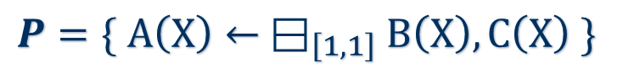
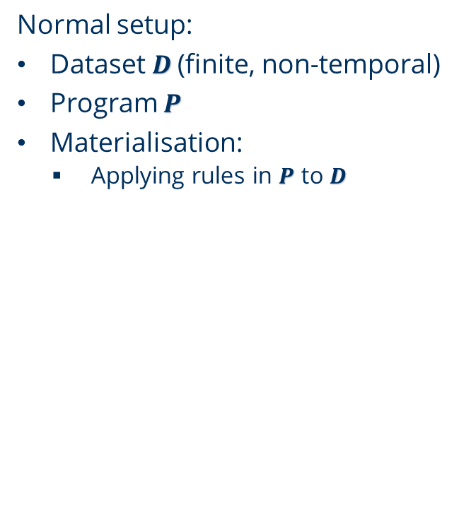
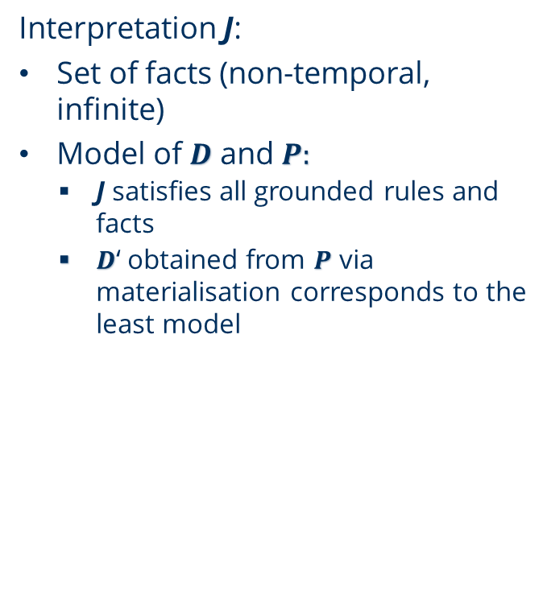
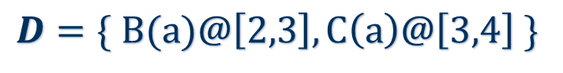
Preliminaries DatalogMTL: Semantics (short)
Normal setup:
Dataset $D$ (finite, non-temporal)
Program $P$
Materialisation:
Applying rules in $P$ to $D$
Interpretation J:
Set of facts (non-temporal, infinite)
Model of $D$ and $P:$
J satisfies all grounded rules and facts
$D$‘ obtained from $P$ via materialisation corresponds to the least model
$$D=\{ B(a)@\left[2,3\right], C\left(a\right)@\left[3,4\right] \}$$
$$P=\{ A\left(X\right)← {\text{⊟}}_{\left[1,1\right]}B\left(X\right), C\left(X\right) \}$$
Rule head holds at joint interval of body

Slide 9

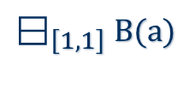

Preliminaries DatalogMTL: Semantics (short)
$${\text{⊟}}_{\left[1,1\right]}$$
Boxminus
$$D$$
$$B(a)$$
2
3
4
5
t
$${\text{⊟}}_{\left[1,1\right]}B(a)$$
2
3
4
5
t

Slide 10
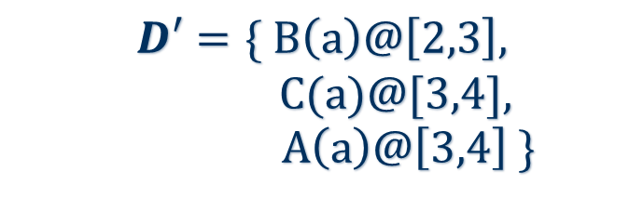
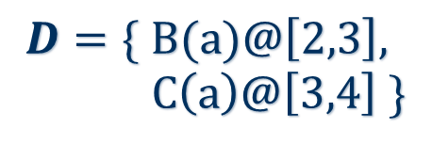
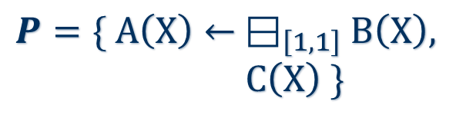

Preliminaries DatalogMTL: Semantics (short)
Example:
$$D=\{ B(a)@\left[2,3\right],$$
$C\left(a\right)@\left[3,4\right] \}$
$$D′=\{ B\left(a\right)@\left[2,3\right],$$
C(a)@[3,4],
$A\left(a\right)@\left[3,4\right] \}$
rule application
$$P=\{ A\left(X\right)← {\text{⊟}}_{\left[1,1\right]}B\left(X\right),$$
$C\left(X\right) \}$
${\text{⊟}}_{\left[1,1\right]}B(a)$ holds at [3,4]

Slide 11

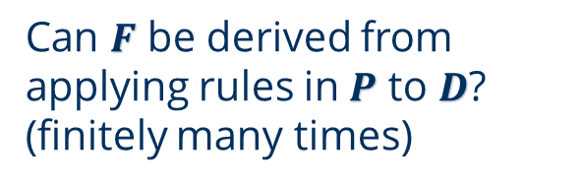
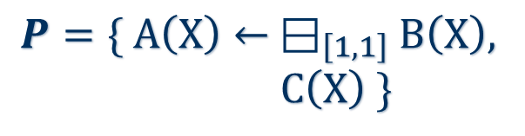
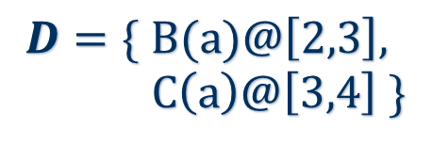
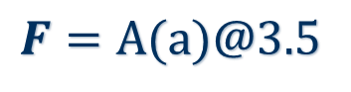
Preliminaries DatalogMTL: Reasoning
Fact entailment:
$$D=\{ B(a)@\left[2,3\right],$$
$C\left(a\right)@\left[3,4\right] \}$
trivial
$$F=B(a)@\left[2,3\right]$$
$$P=\{ A\left(X\right)← {\text{⊟}}_{\left[1,1\right]}B\left(X\right),$$
$C\left(X\right) \}$
$$F=A(a)@3.5$$
?
Can $F$ be derived from applying rules in $P$ to $D$? (finitely many times)

Slide 12
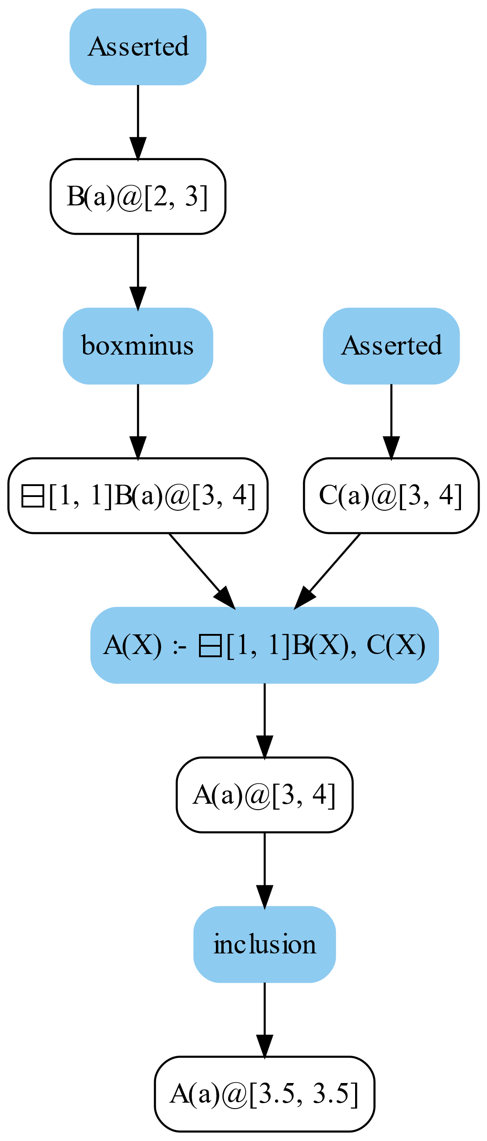
Preliminaries Proof formalisation
Proof:
Hypergraph structure
Vertex: fact
Hyperedge: applied rule
Glass-box approach:
Tracing of all inferences
Global record
Shortest-path algorithm for hypergraph
Dijkstra-like (Evee (Alrabbaa et al., 2021))
?
How to obtain such structure?
?
How to derive a proof?

Slide 13
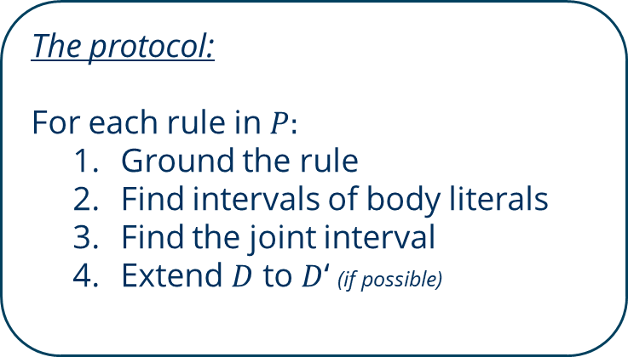
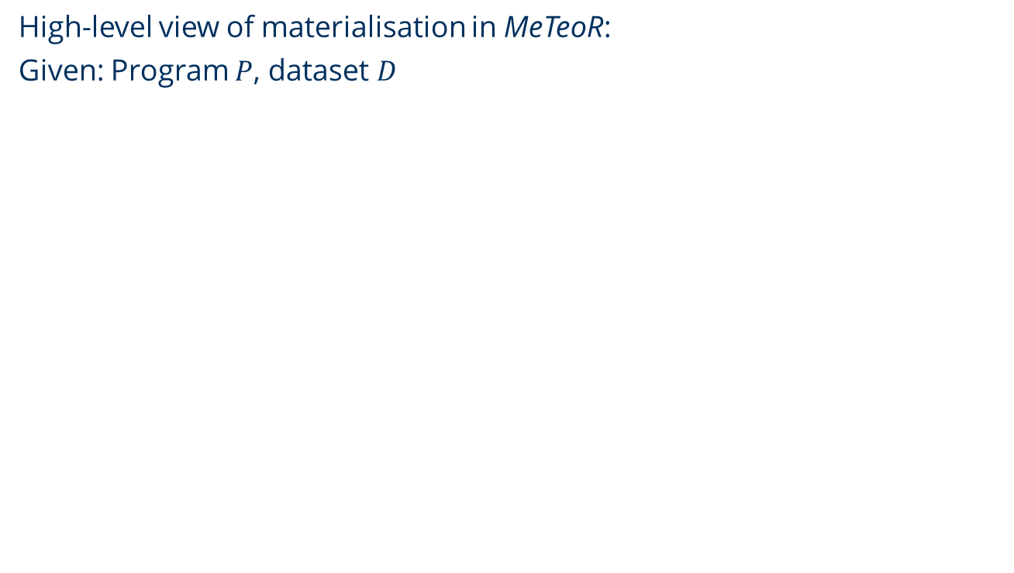
Contribution Overview
High-level view of materialisation in MeTeoR:
Given: Program $P$, dataset $D$
The protocol:
For each rule in $P:$
Ground the rule
Find intervals of body literals
Find the joint interval
Extend $D$ to $D$‘ (if possible)

Slide 14
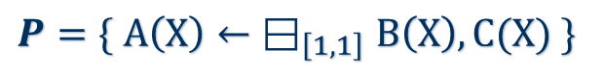
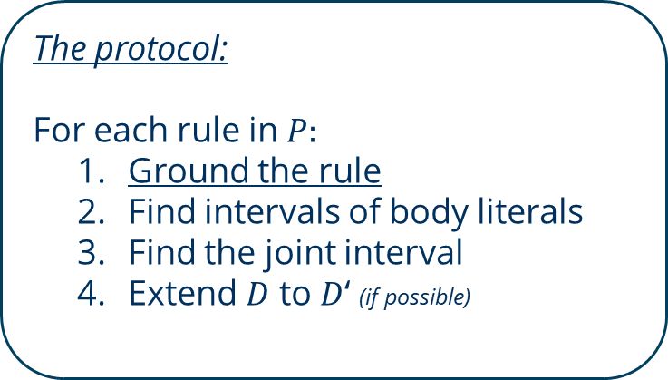

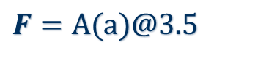
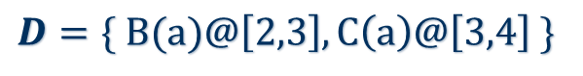
Contribution Running example
$$D=\{ B(a)@\left[2,3\right], C\left(a\right)@\left[3,4\right] \}$$
$$P=\{ A\left(X\right){←\text{⊟}}_{\left[1,1\right]}B\left(X\right),C(X) \}$$
$$\{A\left(a\right)← {\text{⊟}}_{\left[1,1\right]}B\left(a\right),C(a)$$
$$F=A(a)@3.5$$
The protocol:
For each rule in $P:$
Ground the rule
Find intervals of body literals
Find the joint interval
Extend $D$ to $D$‘ (if possible)

Slide 15
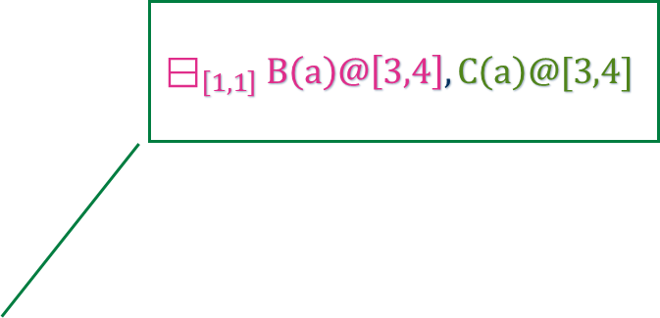
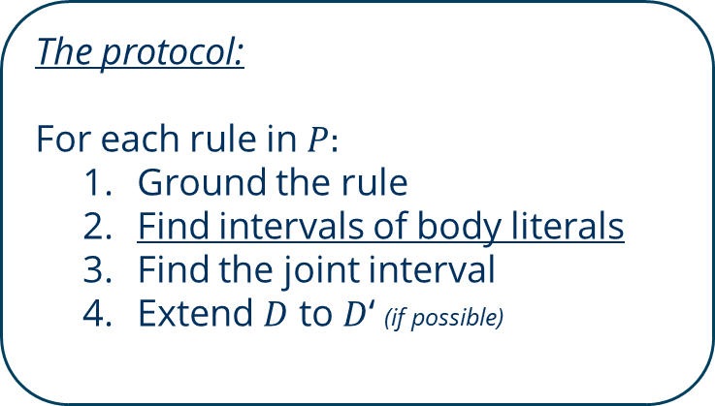
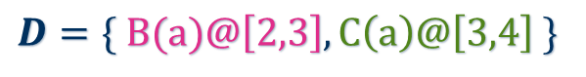
Contribution Running example
$$D=\{ B(a)@\left[2,3\right], C\left(a\right)@\left[3,4\right] \}$$
$$P=\{ A\left(X\right){←\text{⊟}}_{\left[1,1\right]}B\left(X\right),C(X) \}$$
$$F=A(a)@3.5$$
$${\text{⊟}}_{\left[1,1\right]}B\left(a\right)@\left[3,4\right],C\left(a\right)@[3,4]$$
The protocol:
For each rule in $P:$
Ground the rule
Find intervals of body literals
Find the joint interval
Extend $D$ to $D$‘ (if possible)
!
Fact tracing

Slide 16


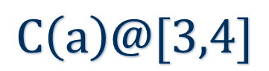
Contribution Tracing and encoding facts
The problems:
Facts with multiple temporal operators
Recursive implementation
Non-nested:
1-level nested (example):
$$C\left(a\right)@[3,4]$$
$${\text{⊟}}_{\left[1,1\right]}B\left(a\right)@[3,4]$$
2-level nested:
$${{\text{⊞}}_{[1,1]}\text{⊟}}_{\left[1,1\right]}B\left(a\right)@[2,3]$$

Slide 17

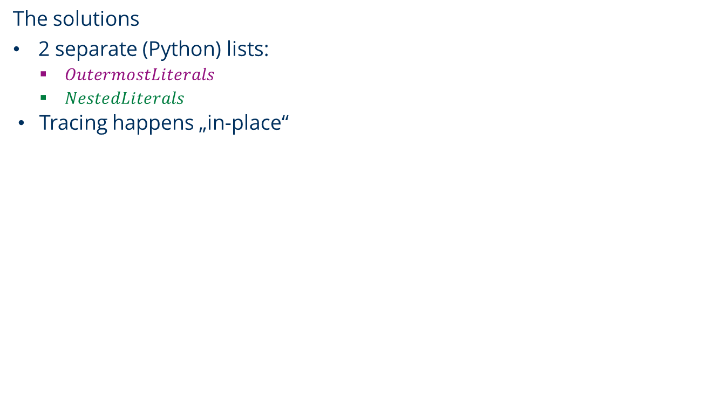


Contribution Tracing and encoding facts
The encoding
The solutions
2 separate (Python) lists:
$OutermostLiterals$
$NestedLiterals$
Tracing happens „in-place“
{
“C(a)”: [ [3,4] ]
}
$$C\left(a\right)@[3,4]$$
$$OutermostLiterals$$
$${\text{⊟}}_{\left[1,1\right]}B\left(a\right)@[3,4]$$

Slide 18


Contribution Tracing and encoding facts
The encoding
The solutions
2 separate (Python) lists:
$OutermostLiterals$
$NestedLiterals$
Tracing happens „in-place“
{
“C(a)”: [ [3,4] ],
“Boxminus[1,1]B(a)”: [ [3,4] ]
}
$$C\left(a\right)@[3,4]$$
$$OutermostLiterals$$
$${\text{⊟}}_{\left[1,1\right]}B\left(a\right)@[3,4]$$

Slide 19


Contribution Tracing and encoding facts
The encoding
The solutions
2 separate (Python) lists:
$OutermostLiterals$
$NestedLiterals$
Tracing happens „in-place“
{
“Boxminus[1,1]B(a)”: [
{
“in_interval”: [2,3],
“out_interval”: [3,4]
“alpha”: “B(a)”,
“rule”: “boxminus”,
}
]
}
$$C\left(a\right)@[3,4]$$
$$NestedLiterals$$
$${\text{⊟}}_{\left[1,1\right]}B\left(a\right)@[3,4]$$

Slide 20
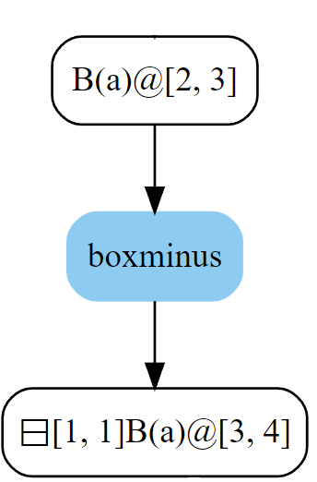
Contribution Tracing and encoding facts
The encoding
{
“Boxminus[1,1]B(a)”: [
{
“in_interval”: [2,3],
“out_interval”: [3,4]
“alpha”: “B(a)”,
“rule”: “boxminus”,
}
]
}

Slide 21

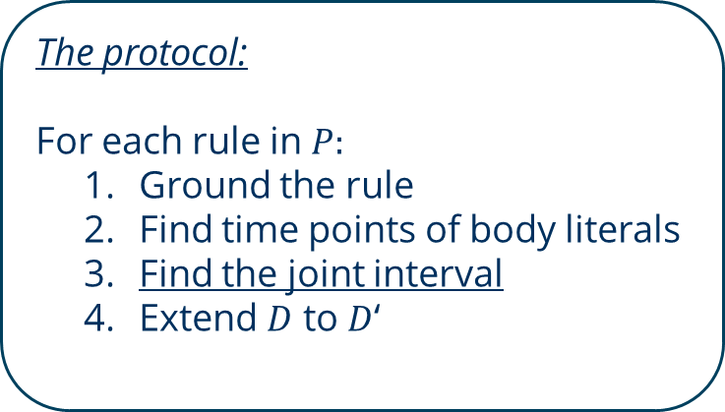
Contribution Running example
$$D=\{ B(a)@\left[2,3\right], C\left(a\right)@\left[3,4\right] \}$$
$$P=\{ A\left(X\right){←\text{⊟}}_{\left[1,1\right]}B\left(X\right),C(X) \}$$
$$F=A(a)@3.5$$
The protocol:
For each rule in $P:$
Ground the rule
Find time points of body literals
Find the joint interval
Extend $D$ to $D$‘
!
“Bundled” facts inside $OutermostLiterals$

Slide 22
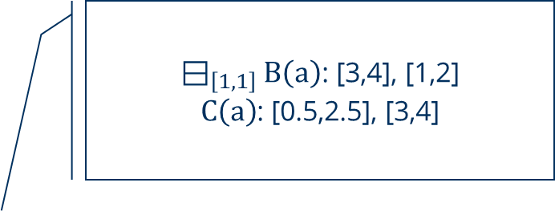

Contribution Running example
$$D=\{ B(a)@\left[2,3\right], C\left(a\right)@\left[3,4\right],B\left(a\right)@\left[0,1\right], C\left(a\right)@\left[0.5,2.5\right] \}$$
$$P=\{ A\left(X\right){←\text{⊟}}_{\left[1,1\right]}B\left(X\right),C(X) \}$$
$$F=A(a)@3.5$$
$OutermostLiterals$:
${\text{⊟}}_{\left[1,1\right]}B\left(a\right)$: [3,4], [1,2]
$C\left(a\right)$: [0.5,2.5], [3,4]
The protocol:
For each rule in $P:$
Ground the rule
Find time points of body literals
Find the joint interval
Extend $D$ to $D$‘

Slide 23

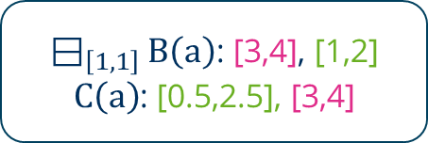
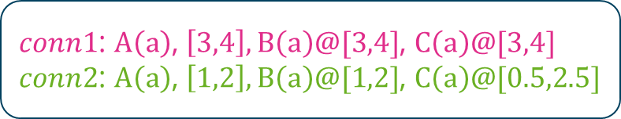
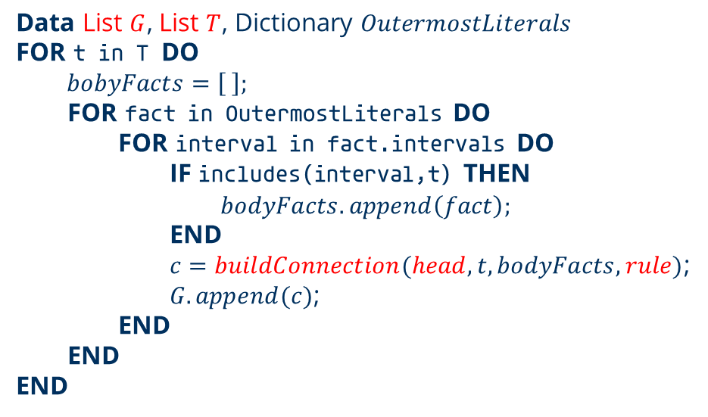


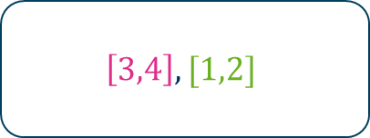
Contribution Filtering intervals
The algorithm:
$$OutermostLiterals$$
Data List $G$, List $T$, Dictionary $OutermostLiterals$
FOR t in T DO
$bobyFacts=\left[ \right];$
FOR fact in OutermostLiterals DO
FOR interval in fact.intervals DO
IF includes(interval,t) THEN
$$bodyFacts.append\left(fact\right);$$
END
$c=buildConnection(head,t,bodyFacts,rule)$;
$G.append(c)$;
END
END
END
${\text{⊟}}_{\left[1,1\right]}B\left(a\right)$: [3,4], [1,2]
$C\left(a\right)$: [0.5,2.5], [3,4]
$$T$$
$$\left[3,4\right], [1,2]$$
$$G$$
$conn1$: $A\left(a\right)$, $\left[3,4\right], B\left(a\right)@[3,4]$, $C\left(a\right)@[3,4]$
$conn2$: $A\left(a\right)$, $\left[1,2\right],B\left(a\right)@[1,2]$, $C\left(a\right)@[0.5,2.5]$

Slide 24
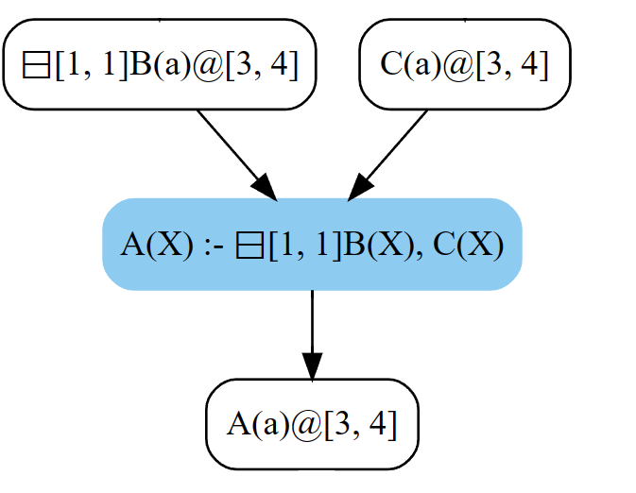
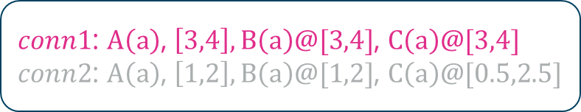

Contribution Filtering intervals
$$G$$
$conn1$: $A\left(a\right)$, $\left[3,4\right], B\left(a\right)@[3,4]$, $C\left(a\right)@[3,4]$
$conn2$: $A\left(a\right)$, $\left[1,2\right],B\left(a\right)@[1,2]$, $C\left(a\right)@[0.5,2.5]$

Slide 25
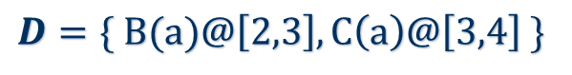
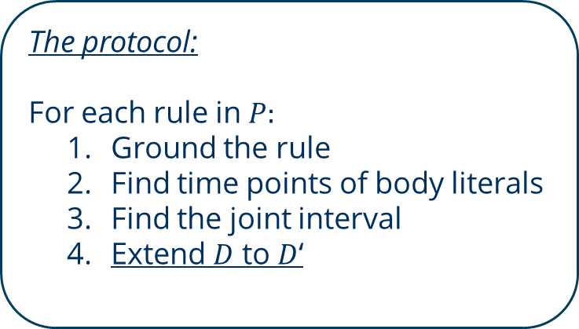
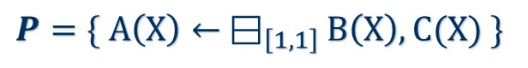
Contribution Running example
$$D=\{ B(a)@\left[2,3\right], C\left(a\right)@\left[3,4\right] \}$$
$$P=\{ A\left(X\right)← {\text{⊟}}_{\left[1,1\right]}B\left(X\right),C(X) \}$$
$$F=A(a)@3.5$$
!
Coalesce intervals
The protocol:
For each rule in $P:$
Ground the rule
Find time points of body literals
Find the joint interval
Extend $D$ to $D$‘

Slide 26
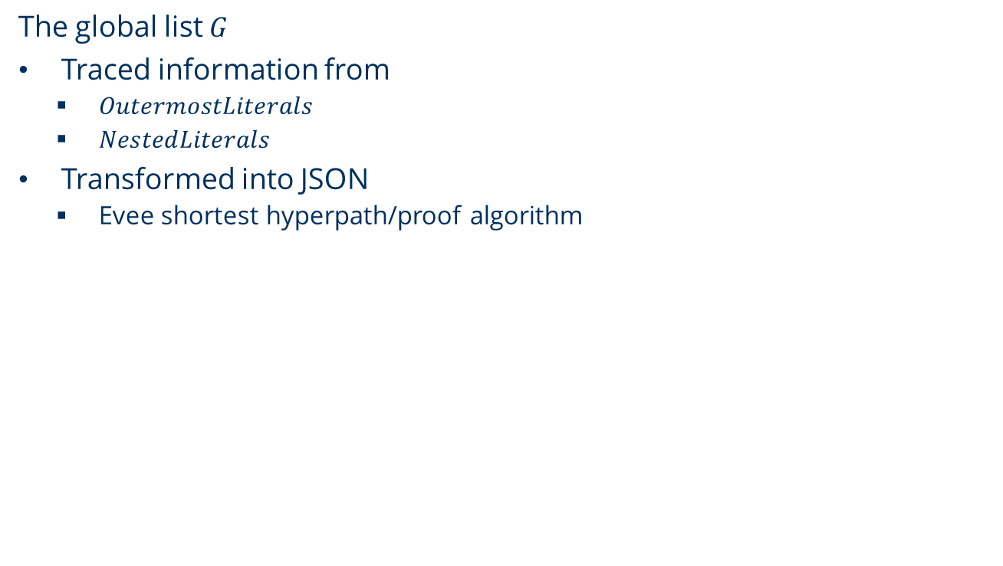
Contribution Running example
The global list $G$
Traced information from
$OutermostLiterals$
$NestedLiterals$
Transformed into JSON
Evee shortest hyperpath/proof algorithm

Slide 27
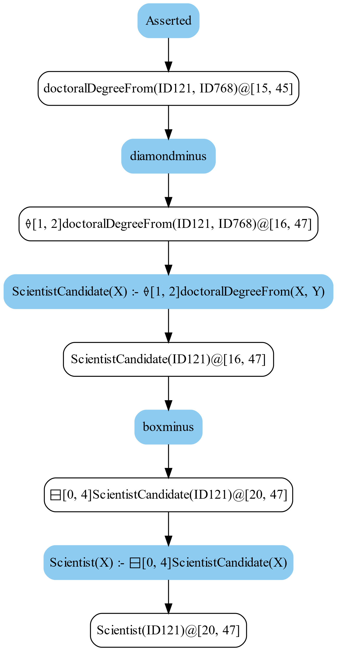
Evaluation Setup
The benchmark:
Dataset:
LUBM generator
10 sizes: 10k … 100k facts
Intervals randomly generated
Program and facts:
85 temporal rules
Entailed facts randomly obtained from
materialisation
Machine configuration
OS: Windows 10 Home Edition (64-Bit)
Processor: AMD Ryzen 5600 (3200MHz)
RAM: 32GB DDR4

Slide 28
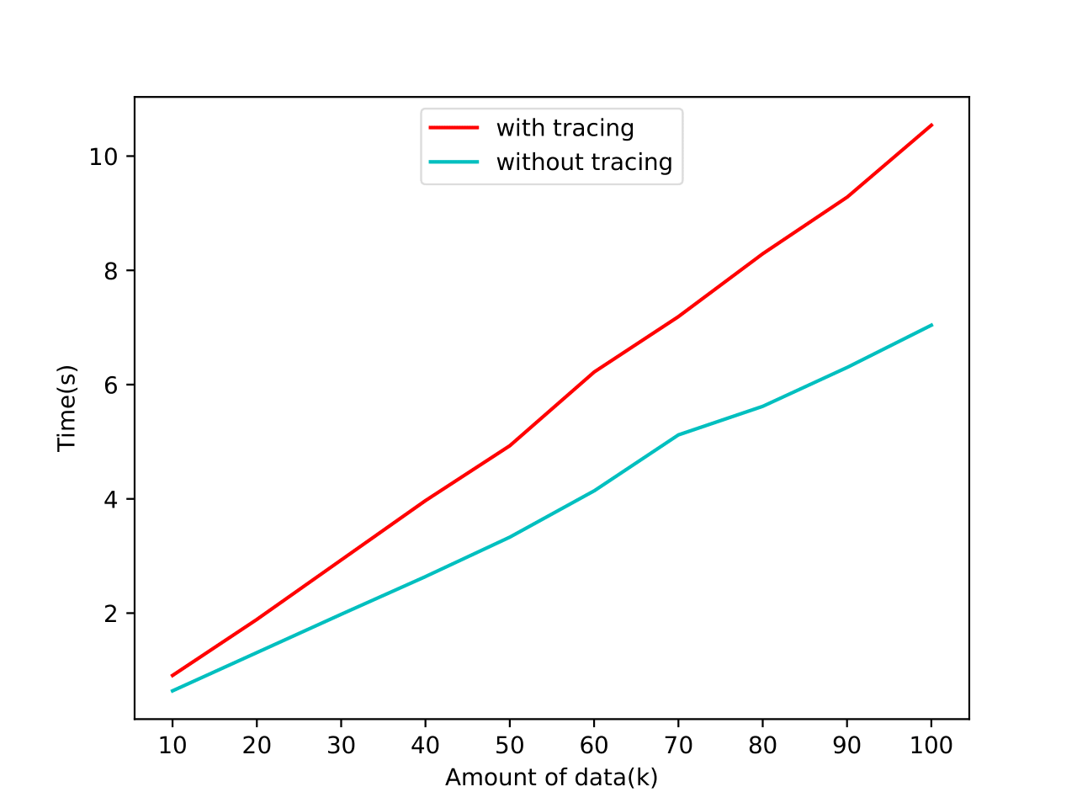
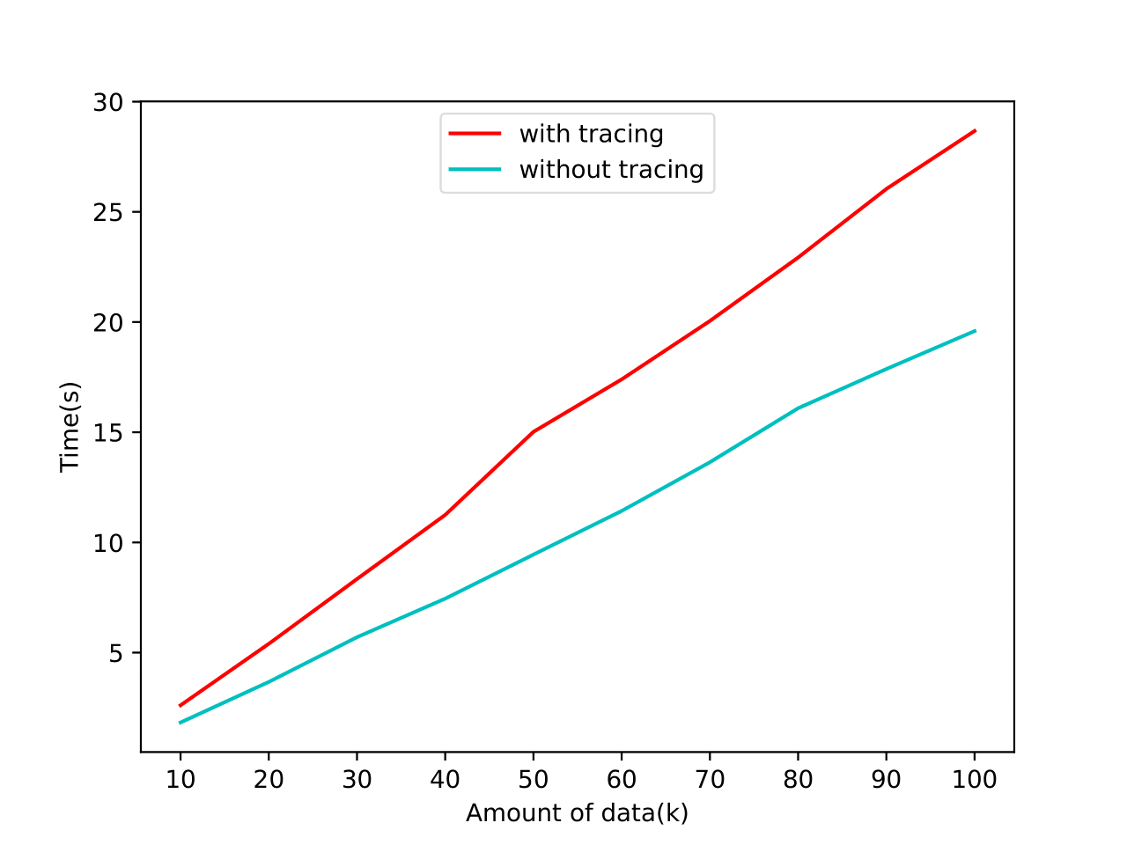
Evaluation Comparison with baseline
CPU time between enabled and disabled tracing
1 round
1 round
2 rounds

Slide 29
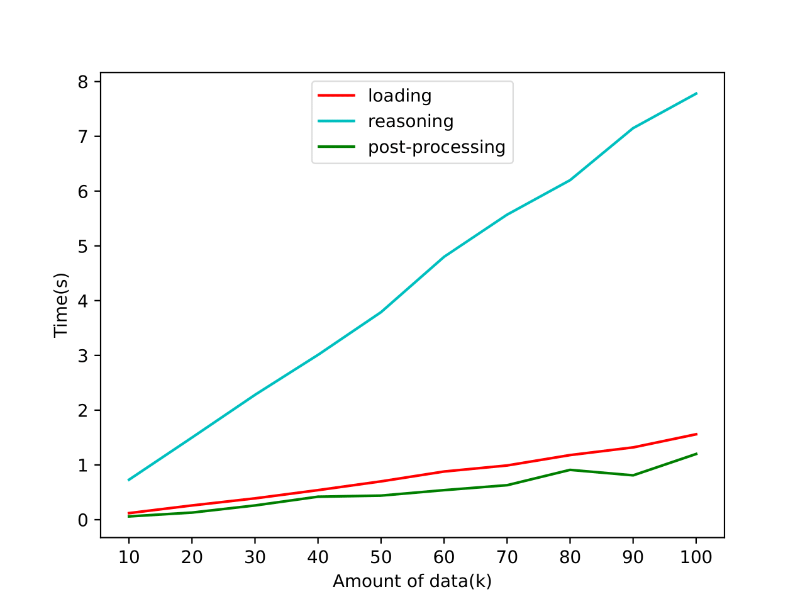
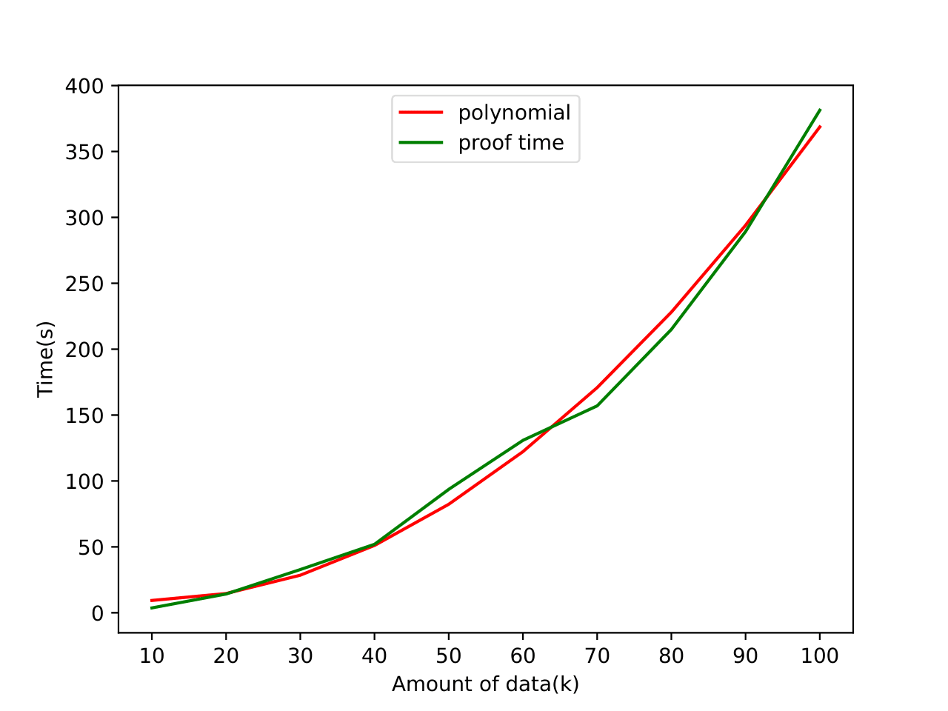
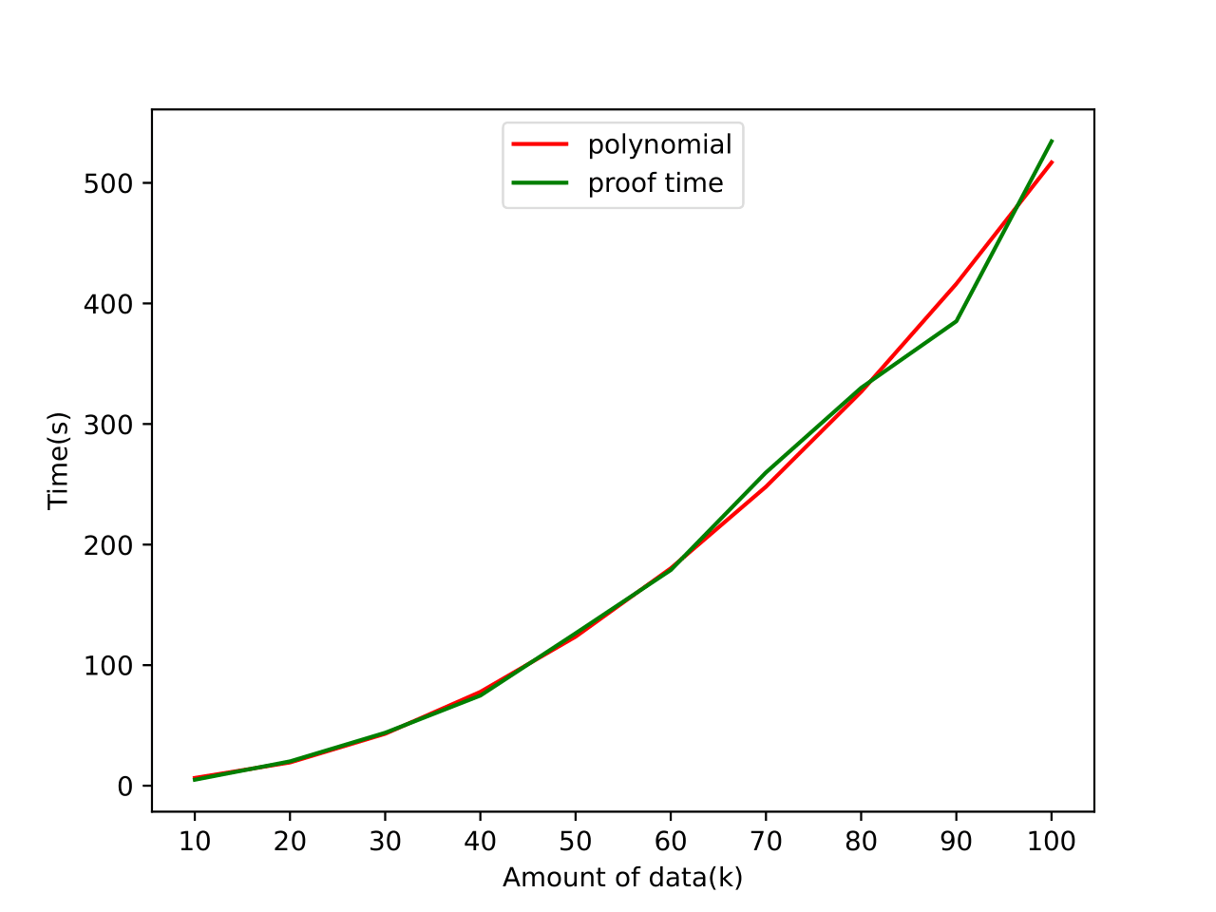
Evaluation Evee’s scalability for minimal proof extraction
CPU time of Evee’s next to a polynomial
1 round
1 round
2 rounds

Slide 30
Conclusion … and future work
Our contribution:
Explainability-capable version of MeTeoR
Facts entailed by finitely many rounds
Performance evaluation
Related project ideas:
Explanability for facts entailed under automata usage
Logging only „relevant“ facts
Optimize Dijkstra algorithm

Slide 31

Many thanks for your attention
https://huggingface.co/spaces/DeepFloyd/IF/discussions/272
The end.

